Slide 1
Correlation
. .

Slide 2
Bivariate Data
Bivariate data is data in which two variables are measured on an individual.
The response variable is the variable whose value can be explained or determined based upon the value of the predictor variable.
A lurking variable is one that is related to the response and/or predictor variable, but is excluded from the analysis

Slide 3
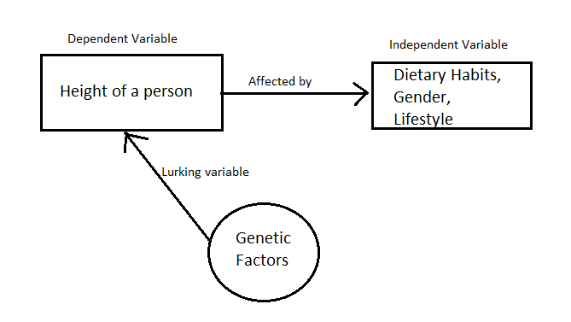

Slide 4
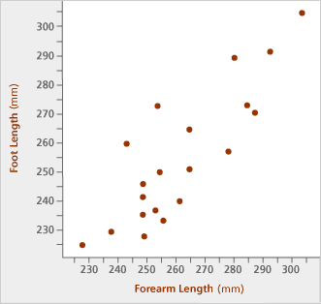
Scatter Diagrams
A scatter diagram shows the relationship between two quantitative variables measured on the same individual.
The value of the predictor is read on the horizontal axis and the response variable on the vertical axis.
Each individual in the data set is represented by a point in the scatter diagram.
Do not connect the points when drawing a scatter diagram.

Slide 5
Example 1: Drawing a Scatter Diagram
P 202, #16. An engineer wanted to determine how the weight of a car affected the gas mileage. The data represent the weight of various domestic cars and their city mileage rating (in mpg) for the 2001 model year.
Weight (pounds)
Miles Per Gallon
3565
19
3440
20
3970
17
3305
19
3340
20
(a) Determine which is the likely predictor variable and which is the likely response variable.
3200
20
3230
19
2560
28
2520
28
3065
20
Predictor variable: weight
3600
18
Response variable: mileage
3300
19
3625
19
3590
19
2605
23
2370
28

Slide 6
Example 1: Drawing a Scatter Diagram
P 202, #16. An engineer wanted to determine how the weight of a car affected the gas mileage. The data represent the weight of various domestic cars and their city mileage rating (in mpg) for the 2001 model year.
Weight (pounds)
Miles Per Gallon
3565
19
3440
20
3970
17
3305
19
3340
20
(b) Draw a scatter diagram.
3200
20
3230
19
Weight vs. Mileage
2560
28
30
2520
28
3065
20
25
3600
18
City Mileage (MPG)
3300
19
20
3625
19
3590
19
15
2605
23
2000
2500
3000
3500
4000
Weight (lbs)
2370
28

Slide 7
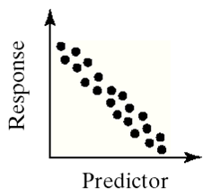
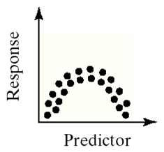
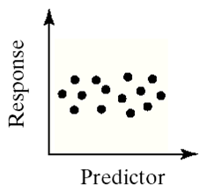
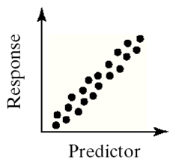
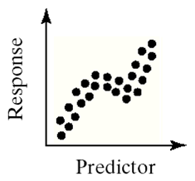
Relationships Between Two Variables
Scatter diagrams reveal the type of relationship or trend that exists between two variables.
Linear (Decreasing)
No trend
Nonlinear
Linear (Increasing)
Nonlinear

Slide 8
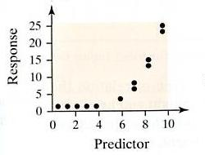
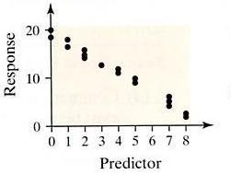
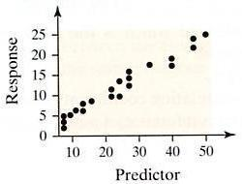
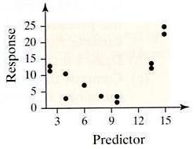
Example 2: Identifying the Trend
P 199, #1 – 4. Determine whether the relationship between the variables is linear or non-linear. If linear, indicate whether there is a positive or negative trend.
1.
2.
3.
4.

Slide 9
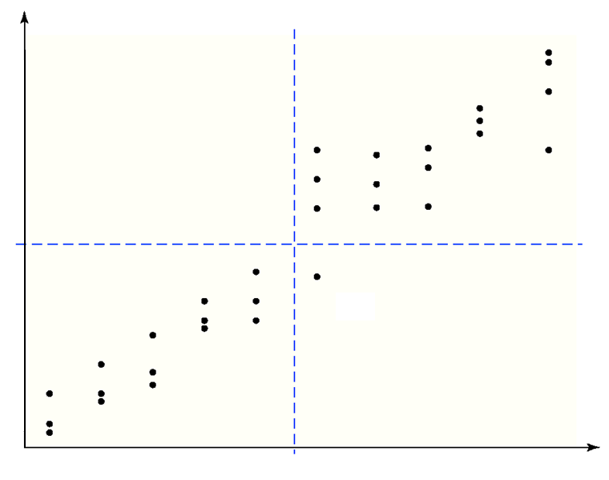


Positive Linear Relationships
Two variables that are linearly related are said to be positively associated when above average values of one variable are associated with above average values of the corresponding variable.
II
I
That is, two variables are positively associated when the values of the predictor variable increase, the values of the response variable also increase.
III
IV

Slide 10
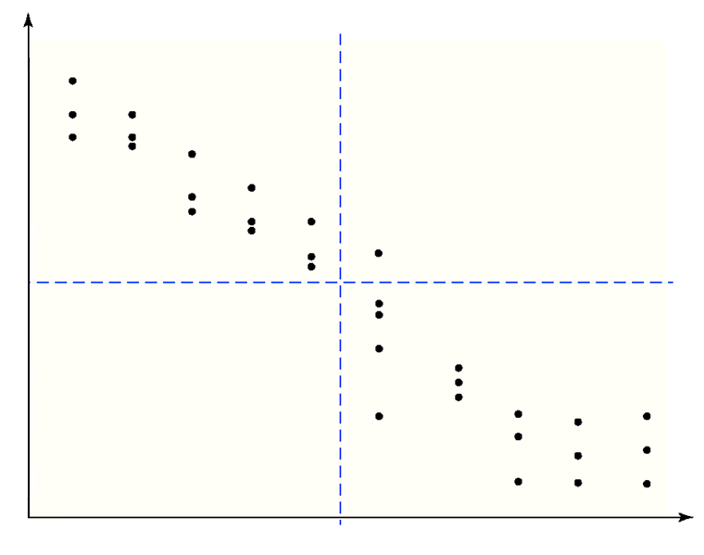
Negative Linear Relationships
Two variables that are linearly related are said to be negatively associated when above average values of one variable are associated with below average values of the corresponding variable.
II
I
That is, two variables are negatively associated when the values of the predictor variable increase, the values of the response variable decrease.
III
IV

Slide 11
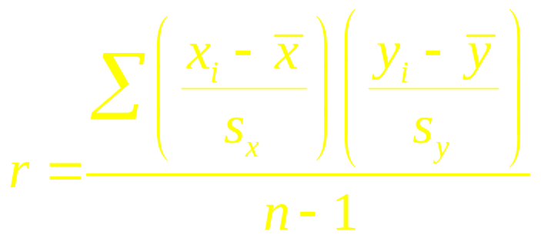
Measuring the Strength of the Linear Relationship
The linear correlation coefficient (or Pearson product moment correlation coefficient) is a measure of the strength of linear relation between two quantitative variables.
We use the Greek letter ρ (rho) to represent the population correlation coefficient and r to represent the sample correlation coefficient.
We shall only present the formula for the sample correlation coefficient:
The correlation coefficient is a unitless measure of association. The units of measure for x and y play no role in the interpretation of r.

Slide 12
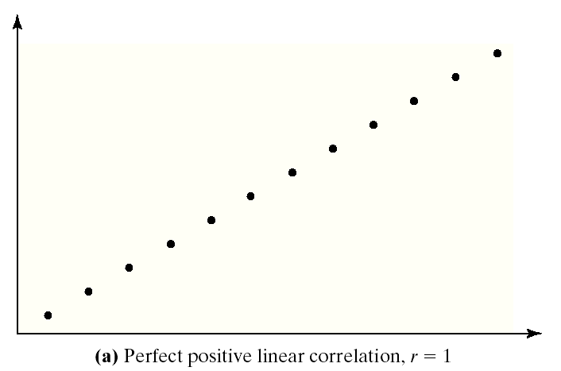
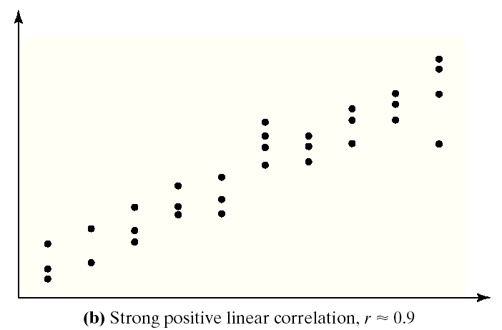
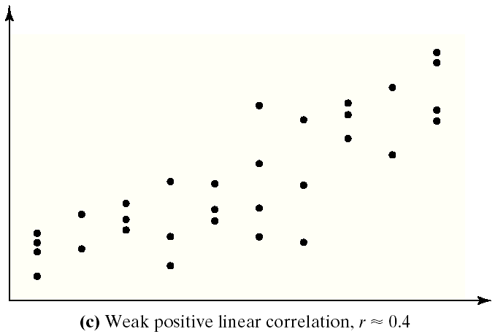
Properties of the Linear Correlation Coefficient
The linear correlation coefficient is always between –1 and 1.
If r = +1, there is a perfect positive linear relation between the two variables.
r = 1
The closer r is to +1, the stronger the evidence of positive association between the two variables.
r ≈ .9
r ≈ .4

Slide 13
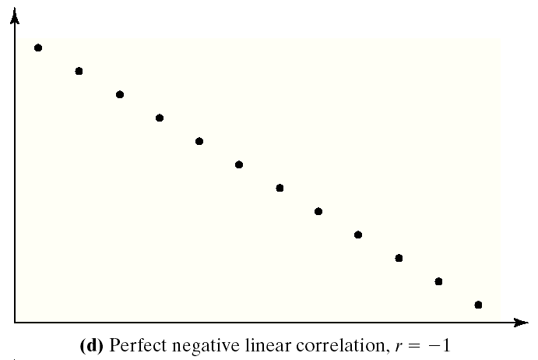
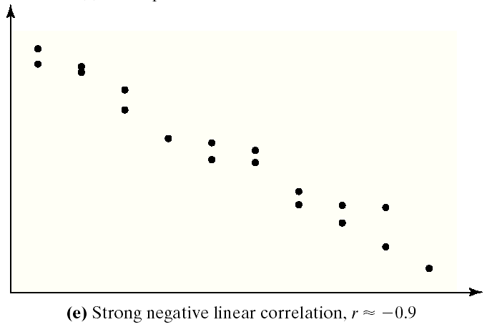
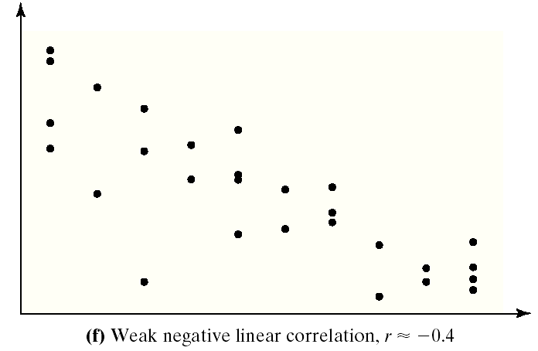
Properties of the Linear Correlation Coefficient
If r = –1 , there is a perfect negative linear relation between the two variables.
The closer r is to –1 , the stronger the evidence of negative association between the two variables.
r = –1
r ≈ –.9
r ≈ –.4

Slide 14
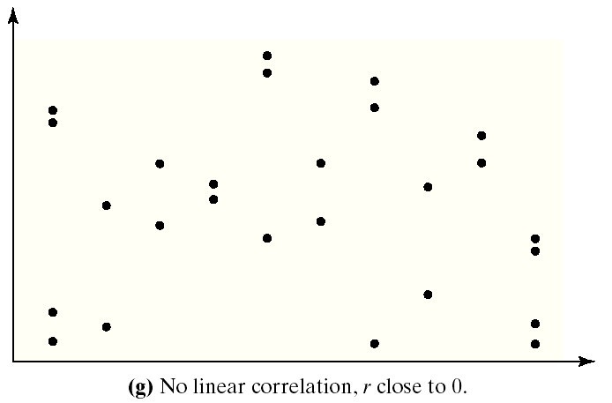
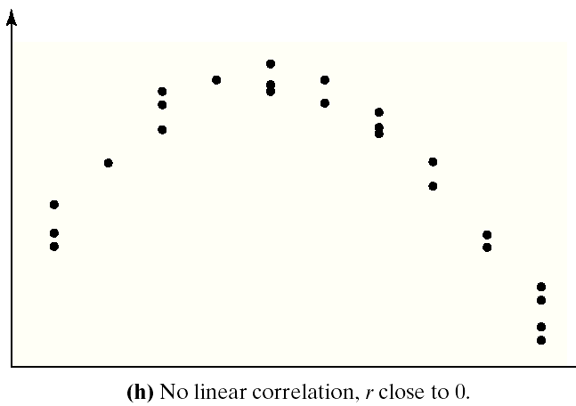
Properties of the Linear Correlation Coefficient
If r is close to 0, there is little or no linear relation between the two variables.
r ≈ 0, no relationship
r ≈ 0, nonlinear relationship

Slide 15
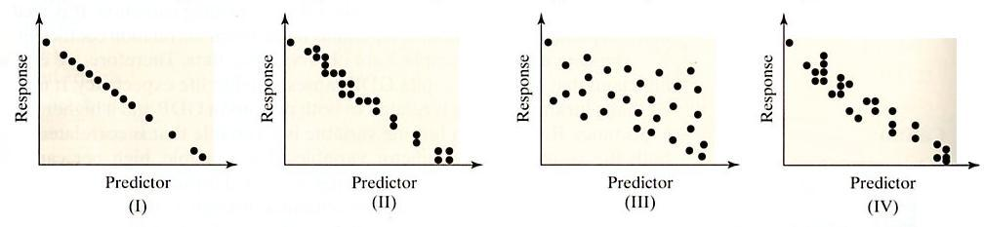
Example 3: Estimating Correlation from a Scatter Plot
P 200, # 6. Match the correlation coefficient to the scatter diagram.
(a) r = –0.969
(b) r = –0.049
(c) r = –1
(d) r = –0.992

Slide 16
Example 4: Anticipating Correlation
P 205, #27. For each of the following statements, state whether you think the variables will have a positive correlation, negative correlation, or no correlation.
(a) Number of children in the household under the age of 3 and expenditures on diapers.
(b) Interest rates on car loans and the number of cars sold.
(c) Number of hours per week on the treadmill and cholesterol level.
(d) Price of a Big Mac and the number of MacDonald’s french fries sold in a week.
(e) Shoe size and IQ.

Slide 17
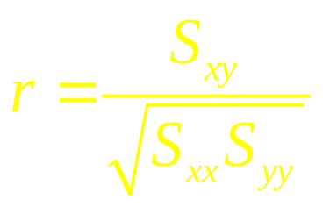
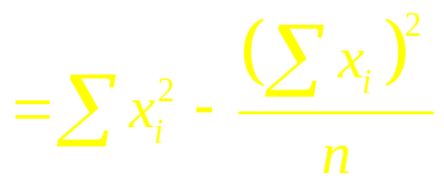

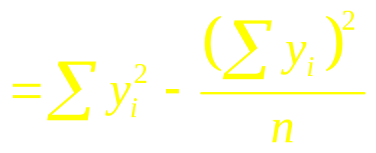

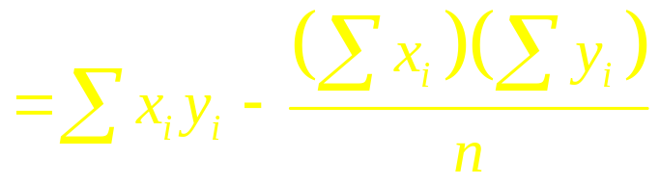

Calculating the Correlation Coefficient
A more efficient formula for computing the correlation coefficient is
where

Slide 18
Example 5: Computing a Correlation
P 200, # 8. Given the data:
x
y
(a) Draw a scatter diagram.
2
5.7
3
5.2
y
5
2.8
6
6
1.9
5
4
6
2.2
3
2
1
0
1
2
3
4
5
6
x

Slide 19
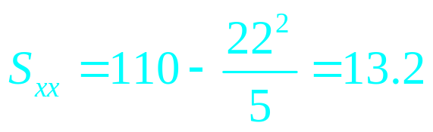
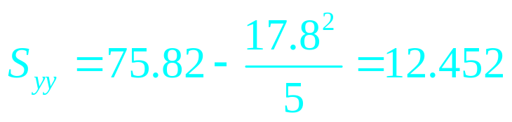
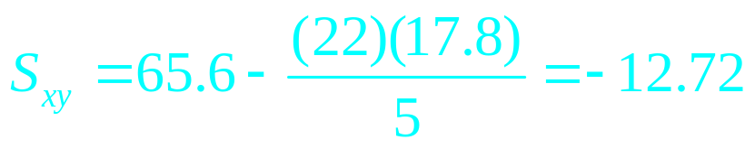
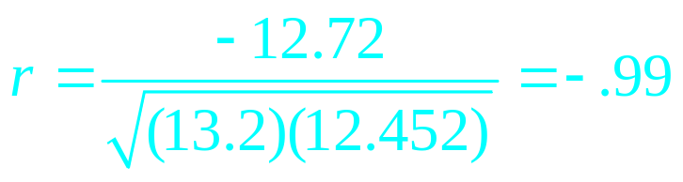
Example 5: Computing a Correlation
P 200, # 8. Given the data:
x
y
x²
y²
xy
(b) Compute the correlation coefficient.
2
5.7
4
32.49
11.4
3
5.2
9
27.04
15.6
5
2.8
25
7.84
14.0
Compute x², y², and xy.
6
1.9
36
3.61
11.4
Sum all columns.
6
2.2
36
4.84
13.2
Calculate SS_{xx}, SS_{yy}, and SS_{xy}.
22
17.8
110
75.82
65.6
Calculate the correlation:

Slide 20
Example 5: Computing a Correlation
P 200, # 8. Given the data:
x
y
x²
y²
xy
(c) Comment on the relationship between x and y.
2
5.7
4
32.49
11.4
3
5.2
9
27.04
15.6
The correlation coefficient indicates there is a strong negative linear relationship between x and y.
5
2.8
25
7.84
14.0
6
1.9
36
3.61
11.4
6
2.2
36
4.84
13.2
22
17.8
110
75.82
65.6

Slide 21
Interpretation of r
Range of Values | Interpretation
±0.91 – ±1.00 | Very High/Strong to Perfect
±0.71 – ±0.90 | High/Strong To Very High/Strong
±0.51 – ±0.70 | Moderate to High/Strong
±0.21 – ±0.50 | Small to Moderate
±0.00 – ±0.20 | No to Small Relationship

Slide 22
Example 6: Weight vs. Mileage Rating
P 202, #16. The data represent the weight of various domestic cars and their city mileage rating (in mpg) for the 2001 model year.
Weight (pounds)
Miles Per Gallon
3565
19
3440
20
(c) What type of relation that appears to exist between the weight of the car between the weight of a car and its city mileage rating.
3970
17
3305
19
3340
20
3200
20
3230
19
There is a negative linear relationship between weight and mileage.
2560
28
Weight vs. Mileage
30
2520
28
3065
20
City Mileage (MPG)
3600
18
25
3300
19
20
3625
19
15
3590
19
2000
2500
3000
3500
4000
2605
23
Weight (lbs)
2370
28

Slide 23
Example 6: Drawing a Scatter Diagram
P 202, #16. The data represent the weight of various domestic cars and their city mileage rating (in mpg) for the 2001 model year.
Weight (pounds)
Miles Per Gallon
3565
19
3440
20
(d) Compute the linear correlation coefficient between the weight of the car between the weight of a car and its city mileage rating.
3970
17
3305
19
3340
20
3200
20
3230
19
r = –.92
2560
28
Weight vs. Mileage
30
2520
28
3065
20
City Mileage (MPG)
3600
18
25
3300
19
20
3625
19
15
3590
19
2000
2500
3000
3500
4000
2605
23
Weight (lbs)
2370
28

Slide 24
Correlation & Causation
A word of caution when interpreting the correlation coefficient:
A linear correlation coefficient that implies a strong positive or negative association that is computed using observational data does not imply causation among the variables.
The predictor and response variables may both be determined by an unknown lurking variable.
If data are obtained through a controlled experiment, then a strong linear correlation also implies causation.

Slide 25
Example 7: Brain Size and Intelligence
P 203, #21. Researchers interested in whether a person’s brain size is related to mental capacity selected a sample of 20 students who had SAT scores higher than 1350 and administered an IQ test. Brain size was determined by an MRI scan.
(a) Use SPSS to draw a scatter diagram treating MRI count as the predictor variable and IQ as the response variable.
Gender
MRI Count
IQ
Gender
MRI Count
IQ
Female
816932
133
Male
949395
140
Female
951545
137
Male
1001121
140
Female
991305
138
Male
1038437
139
Female
833868
132
Male
965353
133
Female
856472
140
Male
955466
133
Female
852244
132
Male
1079549
141
Female
790619
135
Male
924059
135
Female
866662
130
Male
955003
139
Female
857782
133
Male
935494
141
Female
948066
133
Male
949589
144

Slide 26
Example 7: Brain Size and Intelligence
P 203, #21. Researchers interested in whether a person’s brain size is related to mental capacity selected a sample of 20 students who had SAT scores higher than 1350 and administered an IQ test. Brain size was determined by an MRI scan.
(b) Use SPSS to compute the correlation coefficient between the MRI count and IQ. Do they appear to be linearly related?
Gender
MRI Count
IQ
Gender
MRI Count
IQ
Female
816932
133
Male
949395
140
Female
951545
137
Male
1001121
140
Female
991305
138
Male
1038437
139
Female
833868
132
Male
965353
133
Female
856472
140
Male
955466
133
Female
852244
132
Male
1079549
141
Female
790619
135
Male
924059
135
Female
866662
130
Male
955003
139
Female
857782
133
Male
935494
141
Female
948066
133
Male
949589
144

Slide 27
Example 7: Brain Size and Intelligence
P 203, #21. Researchers interested in whether a person’s brain size is related to mental capacity selected a sample of 20 students who had SAT scores higher than 1350 and administered an IQ test. Brain size was determined by an MRI scan.
(c) Gender is a lurking variable in the analysis. Draw separate scatter diagrams for each gender. What do you notice?
Gender
MRI Count
IQ
Gender
MRI Count
IQ
Female
816932
133
Male
949395
140
Female
951545
137
Male
1001121
140
Female
991305
138
Male
1038437
139
Female
833868
132
Male
965353
133
Female
856472
140
Male
955466
133
Female
852244
132
Male
1079549
141
Female
790619
135
Male
924059
135
Female
866662
130
Male
955003
139
Female
857782
133
Male
935494
141
Female
948066
133
Male
949589
144

Slide 28
Example 7: Brain Size and Intelligence
P 203, #21. Researchers interested in whether a person’s brain size is related to mental capacity selected a sample of 20 students who had SAT scores higher than 1350 and administered an IQ test. Brain size was determined by an MRI scan.
(d) Calculate the correlation coefficient separately for males and females. Do you still believe that MRI count and IQ are linearly related?
Gender
MRI Count
IQ
Gender
MRI Count
IQ
Female
816932
133
Male
949395
140
Female
951545
137
Male
1001121
140
Female
991305
138
Male
1038437
139
Female
833868
132
Male
965353
133
Female
856472
140
Male
955466
133
Female
852244
132
Male
1079549
141
Female
790619
135
Male
924059
135
Female
866662
130
Male
955003
139
Female
857782
133
Male
935494
141
Female
948066
133
Male
949589
144

